Slide 1
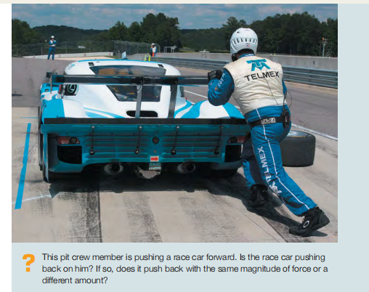




Slide 2
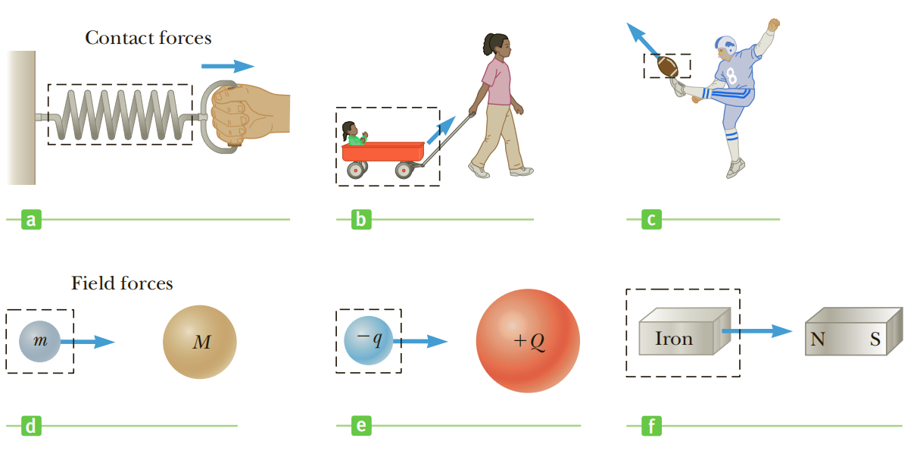
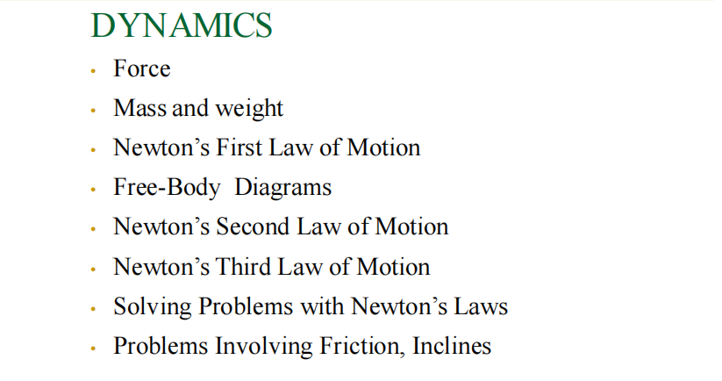

Slide 3
The Fundamental Forces
Gravity, tension forces, compression forces, contact forces, electric forces, friction forces—how many kinds of forces are there? At present, physicists identify three basic forces: the gravitational force, the electroweak force, and the strong force.
Gravity is the weakest of the fundamental forces, but because it acts attractively between all matter, gravity’s effect is cumulative. That makes gravity the dominant force in the large-scale universe, determining the structure of planets, stars, galaxies, and the universe itself.
The electroweak force subsumes electromagnetism and the weak nuclear force. Virtually all the nongravitational forces we encounter in everyday life are electromagnetic, including contact forces, friction, tension and compression forces, and the forces that bind atoms into chemical compounds. The weak nuclear force is less obvious, but it’s crucial in the Sun’s energy production—providing the energy that powers life on Earth.
The strong force describes how particles called quarks bind together to form protons, neutrons, and a host of less-familiar particles. The force that joins protons and neutrons to make atomic nuclei is a residue of the strong force between their constituent quarks

Slide 4
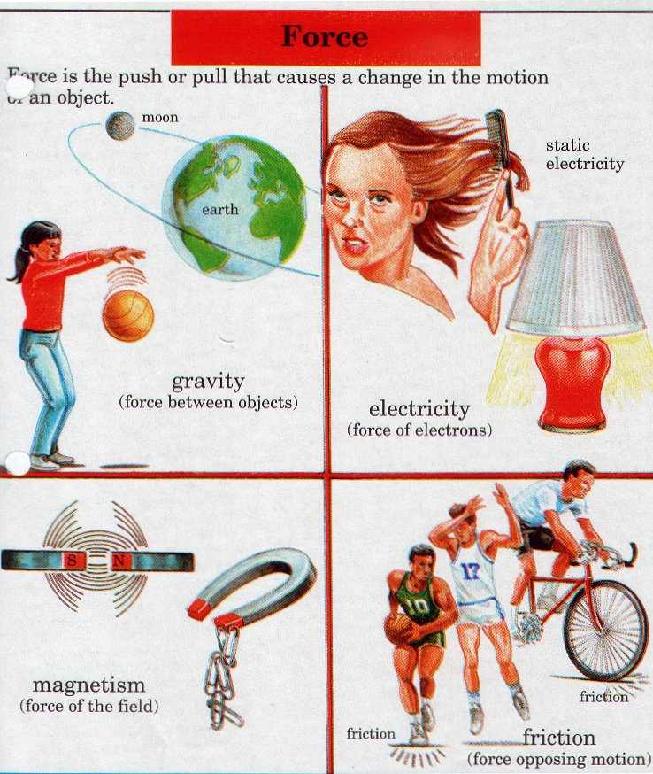
Four Forces Known in the Universe
Electromagnetic- caused from electric and magnetic interactions
Strong Nuclear- Responsible for holding nucleus together in the atom; strongest force; acts over the shortest distance
Gravitation- weakest force; acts over the longest distance
Weak Nuclear- Responsible for radioactivity in atoms

Slide 5
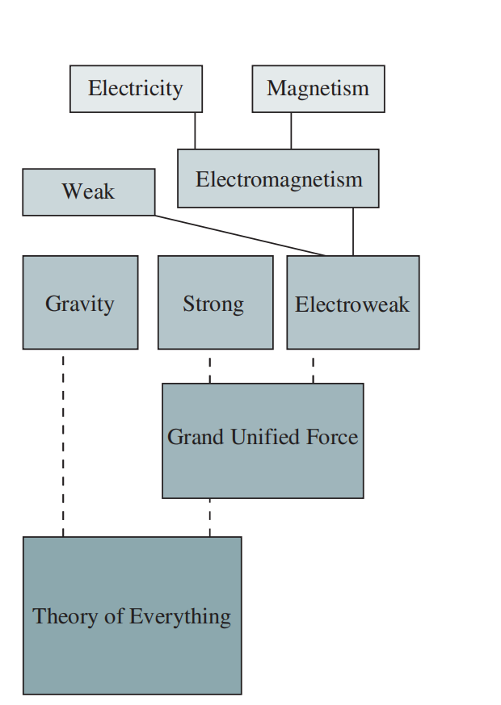

Slide 6

The principles of dynamics were clearly stated for the first time by Sir Isaac
Newton (1642–1727); today we call them Newton’s laws of motion.
But what causes bodies to move the way that they do? For example, why does a dropped feather fall more slowly than a dropped baseball? Why do you feel pushed backward in a car that accelerates forward? The answers to such questions take us into the subject of dynamics, the relationship of motion to the forces that cause it.
Dynamics is the study of motion with reference to the force causing it. Central to the concept of dynamics are linear momentum and the Newton’s laws of motion.

Slide 7
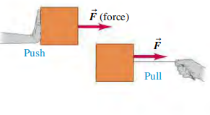
The first law states that when the net force on a body is zero, its motion doesn’t change.
The second law tells us that a body accelerates when the net force is not zero.
The third law relates the forces that two interacting bodies exert on each other
Newton’s laws are the foundation of classical mechanics (also called Newtonian mechanics); using them, we can understand most familiar kinds of motion. Newton’s laws need modification only for situations involving extremely high speeds (near the speed of light) or very small sizes (such as within the atom).

Slide 8
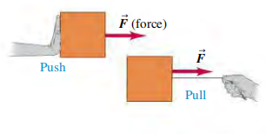
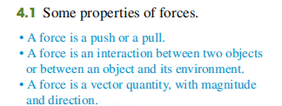
Forces and inTeracTions
A force is a push or a pull. A better definition is that a force is an interaction between two bodies or between a body and its environment.
When a force involves direct contact between two bodies, such as a push or pull that you exert on an object with your hand, we call it a contact force.

Slide 9
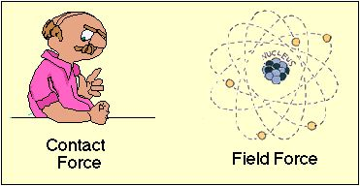
Two Main Types Of Forces: Contact And Field
Contact Force
Exists when an object from the external world touches a system and exerts a force on it.
Think About a Book on a Table
If you push it, you are exerting a contact force
If you put it down, no longer interacting…
so no more force from you But table is touching it- table is now exerting a force
Field Force
An object can move without something directly touching it
What if you dropped the book?
It falls due to gravity
Gravitational Force is a field force.
They affect movement without being in physical contact
Can you think of other field forces?
Magnetic fields
Electric Forces
Nuclear Forces

Slide 10
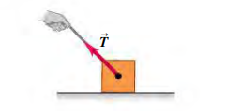
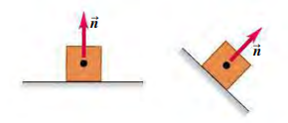
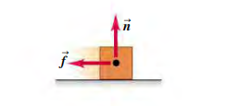
Four common types of forces
Normal force n: When an object rests or pushes on a surface, the surface exerts a push on it that is directed perpendicular to the surface.
Tension force T: A pulling force exerted on an object by a rope, cord, etc.
Weight w: The pull of gravity on an object is a long-range force (a force that acts over a distance). The gravitational force that the earth exerts on your body is called your weight.
Friction force f S : In addition to the normal force, a surface may exert a friction force on an object, directed parallel to the surface.
In addition to contact forces, there are long-range forces that act even when the bodies are separated by empty space

Slide 11
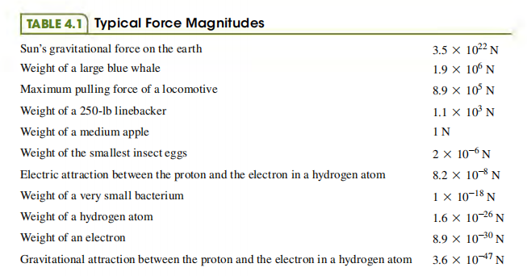
Four common types of forces
A common instrument for measuring force magnitudes is the spring balance.
It consists of a coil spring enclosed in a case with a pointer attached to one end.
When forces are applied to the ends of the spring, it stretches by an amount that depends on the force.

Slide 12
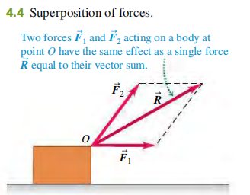
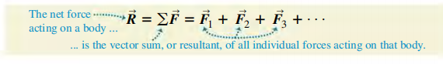
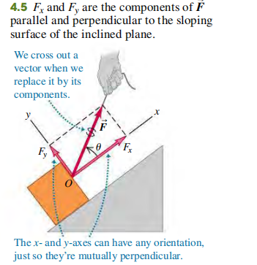
superposition of Forces
any number of forces applied at a point on a body have the same effect as a single force equal to the vector sum of the forces. This important principle is called superposition
of forces.
For the case shown in Fig. 4.5, both F_{x} and F_{y} are positive; in other situations, depending on your choice of axes and the orientation of the force F, either F_{x} or F_{y} may be negative or zero

Slide 13
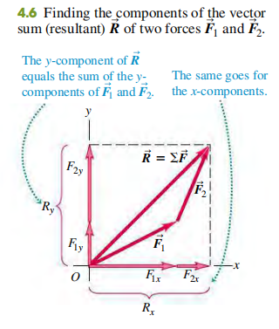
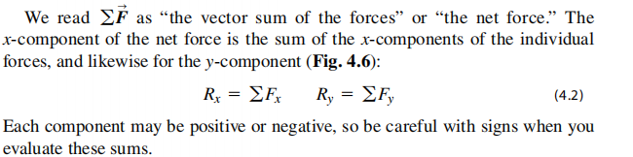
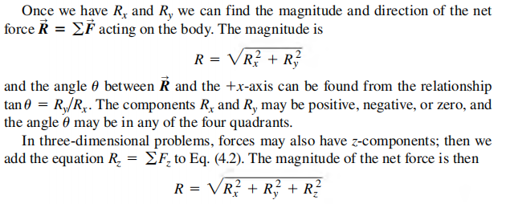
superposition of Forces

Slide 14
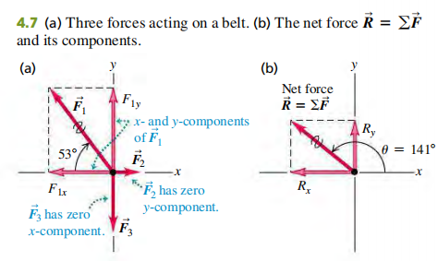
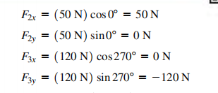
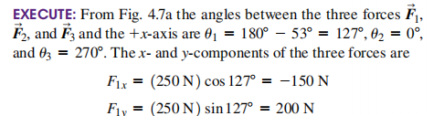
Three professional wrestlers are fighting over a champion’s belt. Figure 4.7a shows the horizontal force each wrestler applies to the belt, as viewed from above. The forces have magnitudes F₁ = 250 N,
F₂ = 50 N, and F₃ = 120 N. Find the x- and y-components of the net force on the belt, and find its magnitude and direction.

Slide 15
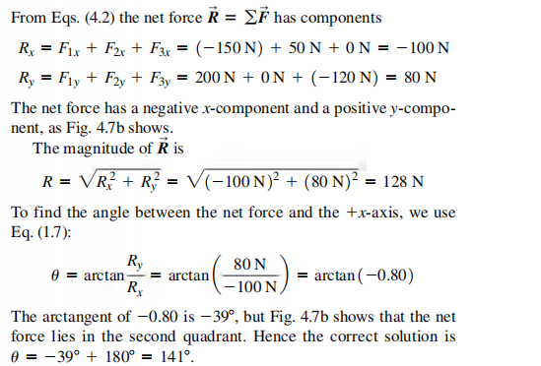

Slide 16
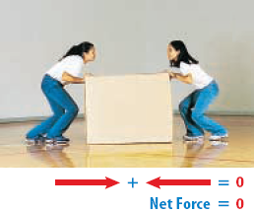
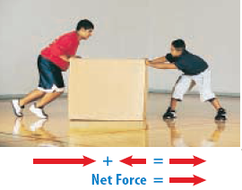
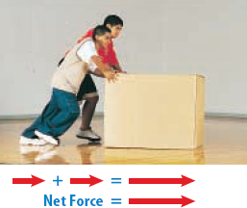
Balanced Versus Unbalanced
Balanced forces cause no acceleration.
Forces are additive
Unbalanced forces cause acceleration.
© 2021 Wordnota Solutions.

Slide 17
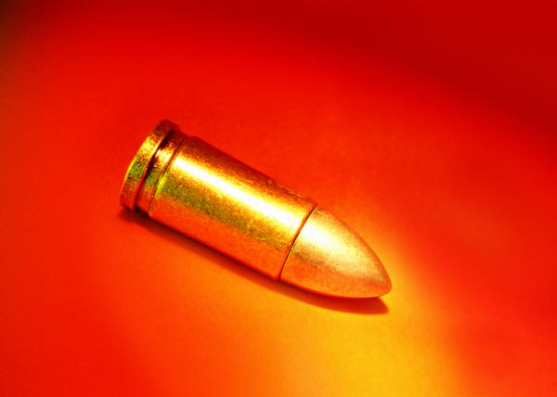
High Mass Low Mass
Something very small (low mass) that’s changing speed very quickly (high acceleration), like a bullet, can still have a great force.
Something very small changing speed very slowly will have a very weak force.
Something very massive (high mass) that’s changing speed very slowly (low acceleration), like a glacier, can still have great force.

Slide 18
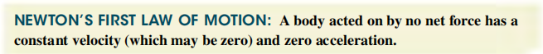
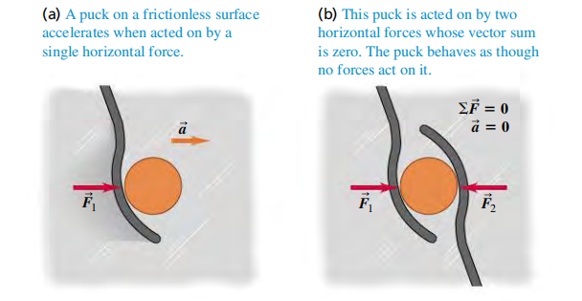
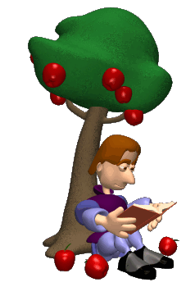
NewTon’s FirsT Law
The tendency of a body to keep moving once it is set in motion is called inertia.
Inertia is also the tendency of a body at rest to remain at rest.

Slide 19
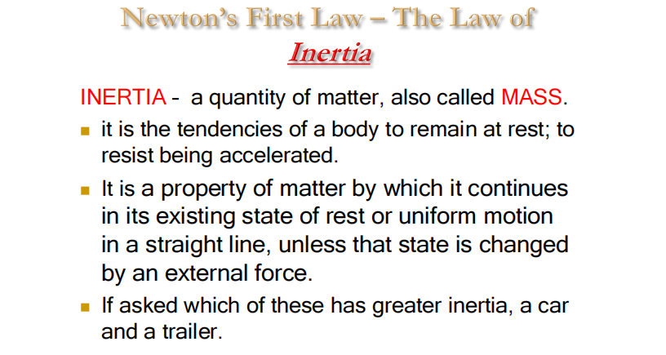
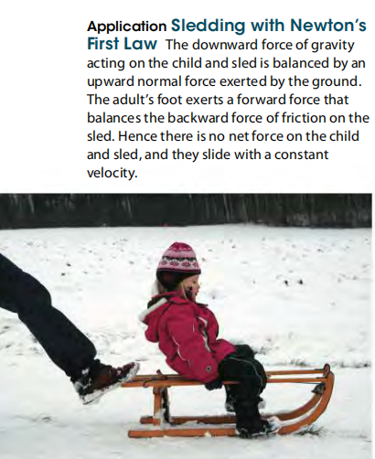

Slide 20
NewTon’s FirsT Law
When a body is either at rest or moving with constant velocity (in a straight
line with constant speed), we say that the body is in equilibrium. For a body to
be in equilibrium, it must be acted on by no forces, or by several forces such that their vector sum—that is, the net force—is zero:
A spaceship is moving in the vacuum of outer space, far from any star or planet, when its engine dies. As a result, the spaceship slows down and stops. What does Newton’s first law say about this scene?
No forces act on the spaceship after the engine dies, so according to Newton’s first law it will not stop but will continue to move in a straight line with constant speed

Slide 21
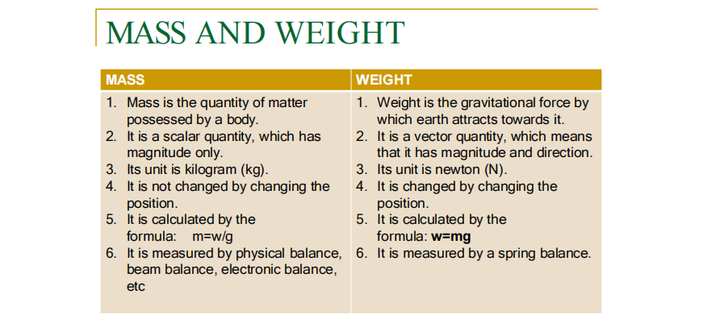

Slide 22

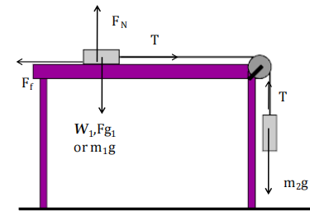
A pictorial representation of all the forces acting on an object complete with labels. Or a diagram showing all forcesacting on a body using arrows, considering body as a point mass.
Free-body diagrams are essential to help identify the relevant forces. A free-body diagram shows the chosen body by itself, “free” of its surroundings, with vectors drawn to show the magnitudes and directions of all the forces that act on the body.

Slide 23
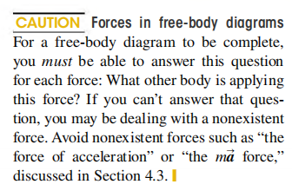
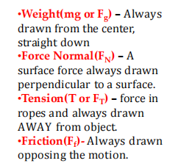
Note: if the body is pulled at an angle, resolve to component of x and y

Slide 24
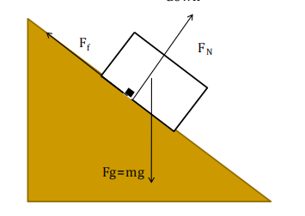
TIPS for solving problems
1. Draw a FBD
2.Resolve anything into COMPONENTS
3. Write equations of equilibrium
4. Solve for unknowns
Since the Fnet = 0, a system moving at a constant speed or at rest MUST be at
EQUILIBRIUM.
NOTE: In an incline plane, there is no Friction(F_{f})- because the object is sliding down

Slide 25
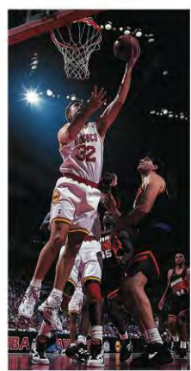
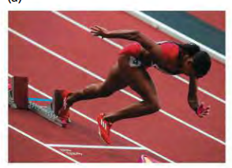
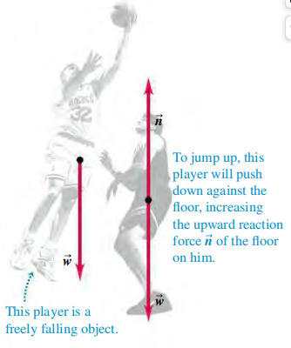
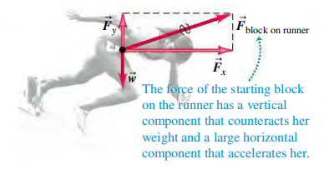
Examples of free-body diagrams

Slide 26
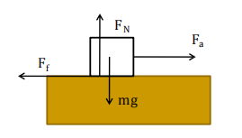
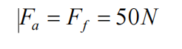
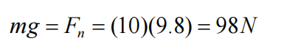
A 10-kg box is being pulled across the table to the
right at a constant speed with a force of 50N.
a) Calculate the Force of Friction
b) Calculate the Force Normal

Slide 27
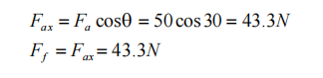
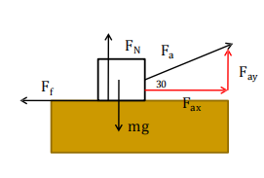
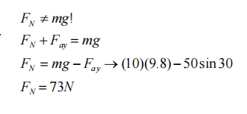
Suppose the same box is now pulled at an angle of 30 degrees above the horizontal.
a) Calculate the Force of Friction
b) Calculate the Force Normal

Slide 28
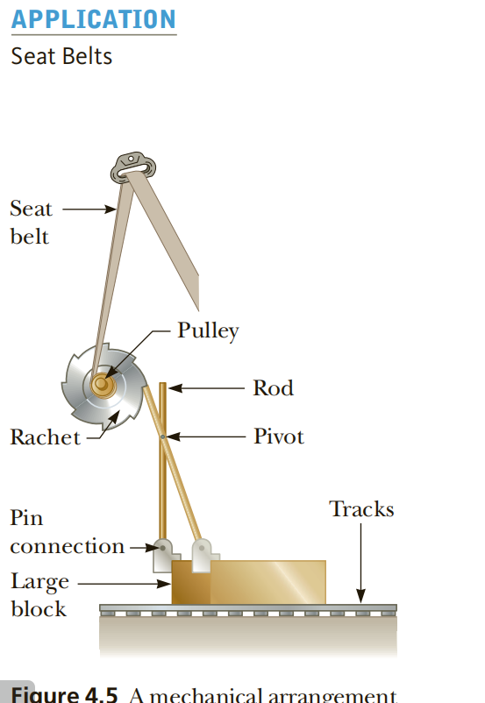
Inertia can be used to explain the operation of one type of seat belt mechanism.
The purpose of the seat belt is to hold the passenger firmly in place relative to the car, to prevent serious injury in the event of an accident. Figure 4.5 illustrates how one type of shoulder harness operates. Under normal conditions, the ratchet turns freely to allow the harness to wind on or unwind from the pulley as the passenger moves. In an accident, the car undergoes a large acceleration and rapidly comes to rest. Because of its inertia, the large block under the seat continues to slide forward along the tracks. The pin connection between the block and the rod causes the rod to pivot about its center and engage the ratchet wheel. At this point, the ratchet wheel locks in place and the harness no longer unwinds.

Slide 29
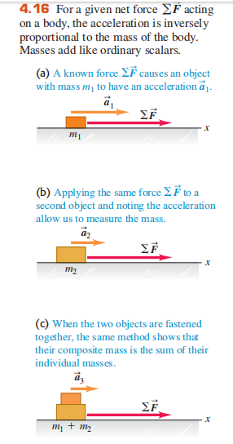
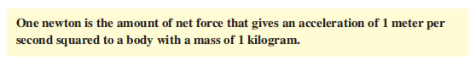


Newton’s Second Law

Slide 30



Newton’s Second Law
A worker applies a constant horizontal force with magnitude 20 N to a box with mass 40 kg resting on a level floor with negligible friction. What is the acceleration of the box?

Slide 31




Slide 32


A mass, m₁ = 3.00kg, is resting on a frictionless horizontal table is connected to a cable that passes over a pulley and then is fastened to a hanging mass, m₂ = 11.0 kg as shown below. Find the
acceleration of each mass and the tension in the cable.
F_{Net} = ma
F
N
m₂ g − T = m₂a T = m₁a
T
T
m₂ g − m₁a = m₂a
m₁g
m₂ g = m₂a + m₁a m₂ g = a(m₂ + m₁ )
m₂g
m g (11)(9.8)
a = ² →
= 7.7 m / s²
m₁ + m₂ 14

Slide 33

F_{Net} = ma
m₂ g − T = m₂a T = m₁a
T = (3)(7.7) = 23.1N

Slide 34

Friction
TWO types of Friction
Static – Friction that keeps an object at rest and prevents it from moving
Kinetic – Friction that acts during motion

Slide 35
Force of Friction
The Force of Friction is ^{Ff}
α F_{N}
directly related to the Force Normal.
Mostly due to the fact that BOTH are surface forces
μ = constant of proportionality
μ = coefficien t of friction
^{F}sf ^{F}kf
= μ_{s} F_{N}
= μ_{k} F_{N}
The coefficient of friction is a unitless constant that is specific to the material type and usually less than one.
Note: Friction ONLY depends on the MATERIALS sliding against each other, NOT on surface area.

Slide 36
Example
A 1500 N crate is being pushed across a level floor at a constant speed by a force F of 600 N at an angle of 20° below the horizontal as shown in the figure.
a) What is the coefficient of kinetic friction between the crate and the floor?
F = μ F
F = F_{ax} = F_{a} cosθ = 600(cos 20) = 563.82N
F
f
k N
a
F_{N}
F
f
ay
F = F_{ay} + mg = F_{a} sinθ +1500
F_{N} = 600(sin 20) +1500 = 1705.21N
20
N
F
ax
563.82 = μ_{k} 1705.21
μ_{k} = 0.331
F_{f}
mg

Slide 37
Example
If the 600 N force is instead pulling the block at an angle of 20° above the horizontal as shown in the figure, what will be the acceleration of the crate. Assume that the coefficient of friction is the same as found in (a)
F_{net} = ma
F_{N}
F_{a}
20
^{F}ay
^{F}ax
F_{f}
F_{ax} − F_{f} = ma
mg
F_{a} cosθ − μF_{N} = ma
F_{a} cosθ − μ(mg − F_{a} sinθ ) = ma
600 cos 20 − 0.331(1500 − 600 sin 20) = 153.1a
563.8 − 428.57 = 153.1a
a = 0.883 m / s²

Slide 38
EXAMPLE
An elevator with a mass of 2000 Kg rises with an acceleration of 1.0 m/s².what is the tension in the supporting cable.
T
F_{net} = ma
T − mg = ma
T = ma + mg = 2000×1+ 2000× 9.8
T = 21.6N
■
mg
▪

Slide 39






Slide 40



NEWTON’S THIRD LAW
NEWTON’S THIRD LAW OF MOTION If object A exerts a force on object B (an “action”), then object B exerts a force on object A (a “reaction”). These two forces have the same magnitude but are opposite in direction. These two forces act on different objects.

Slide 41




Slide 42





Class Exercise
A lift moves up and down with an acceleration of $2ms^{−2}.$ In each cases, calculate the reaction of the floor on an object of mass 50kg place on the floor of the lift.
What is the tension in a vertical rope pulling a block of mass $50kg$ with an acceleration of $1ms^{−1}$
(i). When the lift moves upward
$$F=ma$$
$$F=T−mg=ma$$
$$T=ma+mg=m(a+g)$$
$$T=50\left(2+10\right)=600N$$
According to Newton’s second law of motion
$$F=ma$$
$$F=T−mg=ma$$
$$T=ma+mg=m(a+g)$$
$$T=50\left(1+10\right)=550N$$
(ii) When the lift moves downward
$$F=ma$$
$$F=mg−T=ma$$
$$T=mg−ma=m(g−a)$$
$$T=50\left(10−2\right)=400N$$

Slide 43




Class Exercise
Calculate the constant force that will accelerate a body of mass $5×{10}^{3}kg$ from rest to a speed of $50ms^{−1}$ in 30s.
A force of magnitude $100N$ is applied to a body of mass $2kg$ at an angle of ${30}^{o}$ to the horizontal. Calculate the acceleration of the body
$$u=0ms^{−1}, m=5×{10}^{3}kg, v=50ms^{−1}, t=50s$$
Using $v=u+at an making a the subject$
$$a=\frac{v−u}{t}=\frac{50−0}{30}=1.67ms^{−2}$$
$$if F=ma, therfore$$
$$F=5×{10}^{3}×1.67$$
$$F=8.35×{10}^{3}N$$
$$F_{R}=F_{x}=Fcos θ=ma$$
Make ‘a’ the subject of formular
$$a=\frac{Fcosθ}{m}=\frac{100\cos{{30}^{o}}}{2}$$
$$a=43.3ms^{−2}$$

Slide 44




Class Exercise
A Woman of mass 80kg moving on a horizontal frictionless plane with initial speed of $10ms^{−1}$ is pulled $4m$ by a force of magnitude $250N$ in the direction of the applied force. Calculate the final velocity of the woman.
A force of magnitude $5N$ acts on a $2kg$ body moving initially in the direction of the force with speed $4ms^{−1}$. Calculate the distance travelled by the body if the final speed of the body is $6ms^{−1}.$
Recall that $F=ma$
Therefore, $a=\frac{F}{m}=\frac{5}{2}=2.5ms^{−2}$
If $v^{2}=u^{2}+2ax$, then
$$x=\frac{v^{2}−u^{2}}{2a}=\frac{6^{2}+4^{2}}{2×2.5}=$$
$$x=\frac{36−16}{5}=\frac{20}{5}=4m.$$
Since fictional force is zero, then $F=ma$
$250=80×a⇒a=3.125ms^{−2}$
If $v^{2}=u^{2}+2ax$, then
$$v^{2}={10}^{2}+2\left(3.125\right)\left(4\right)$$
$$v^{2}=100+25=125$$
$$v=\sqrt{125}=11.18ms^{−1}$$

Slide 45

Class Exercise
An elevator with a mass of 2000 kg rises with an acceleration of 1.0 m/s/s. What is the tension in the supporting cable?
© 2021 Wordnota Solutions.

